Slide 1

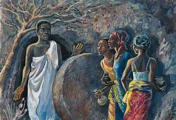
Salvation Is Sealed
=''/>
Luke 24:13-16, 22-35

Slide 2
Familiar Text!
What is the Holy Ghost saying?
Can you empathize with the disciples feelings of doubt and uncertainty?
How did Jesus address their unbelief?
Lesson Aim: That we will AGREE that the Suffering Servant in Isaiah 52:13-53:12 is the resurrected Christ in Luke 24, AFFIRM the joy of knowing the Suffering Servant is the resurrected Jesus Christ, and SHARE the story of the Suffering Servant, who is the resurrected Jesus Christ.

Slide 3

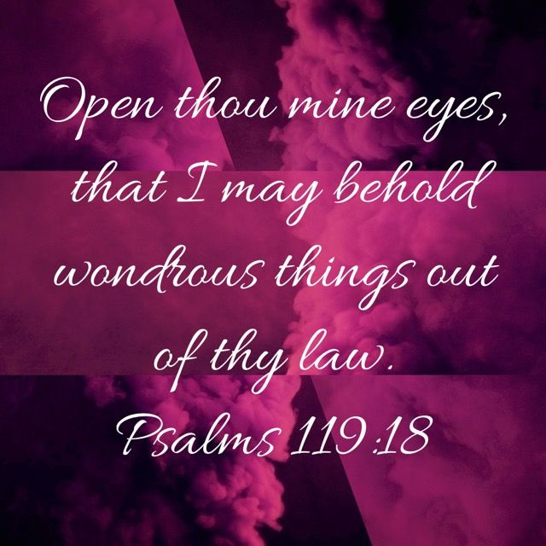
The goal Is Revelation
Refuse to settle only for, OR BECOME PRE-OCCUPIED WITH ONLY information.

Slide 4
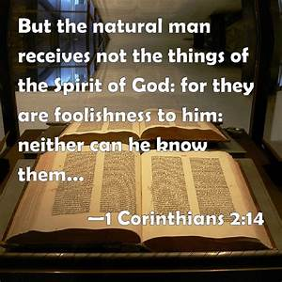
Ensure that your class is a tangent- free, Impress me- free class.

Slide 5
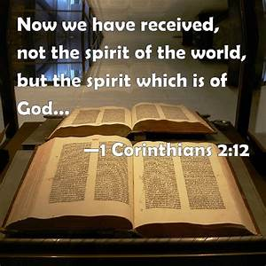
Hebrew and greek have their place, but revelation is Key.
Refuse to allow your knowledge to become a liability.

Slide 6
THE BACKGROUND
Remember, the Old Testament CONCEALED is the New Testament REVEALED. THIS IS THE FOUNDATION LAID FOR PRESENTING THE GOSPEL.

Slide 7
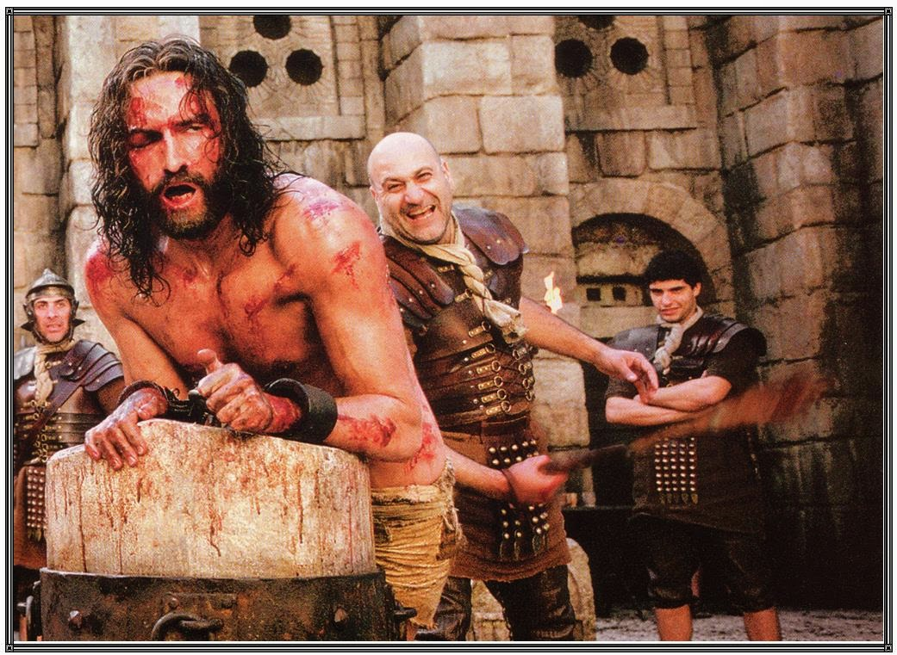
Isa 50:6
I gave my back to the smiters, and my cheeks to them that plucked off the hair: I hid not my face from shame and spitting.
KJV

Slide 8
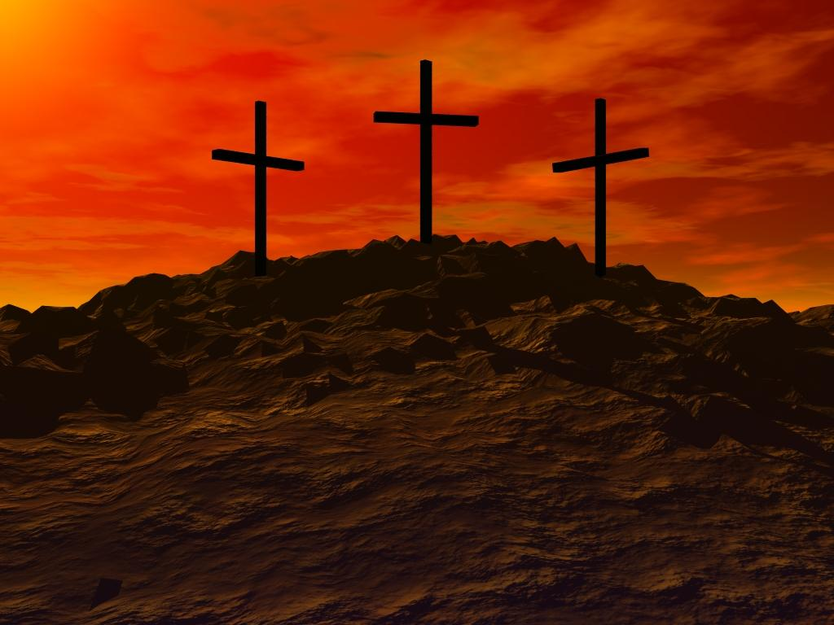
Isa 52:14
As many were astonied at thee; his visage was so marred more than any man, and his form more than the sons of men: KJV
Isa 52:14
But many were amazed when they saw him. His face was so disfigured he seemed hardly human, and from his appearance, one would scarcely know he was a man. NLT

Slide 9
Isa 53:3
He is despised and rejected of men; a man of sorrows, and acquainted with grief: and we hid as it were our faces from him; he was despised, and we esteemed him not.
KJV

Slide 10
Isa 53:5
5 But he was wounded for our transgressions, he was bruised for our iniquities: the chastisement of our peace was upon him; and with his stripes we are healed.
KJV

Slide 11
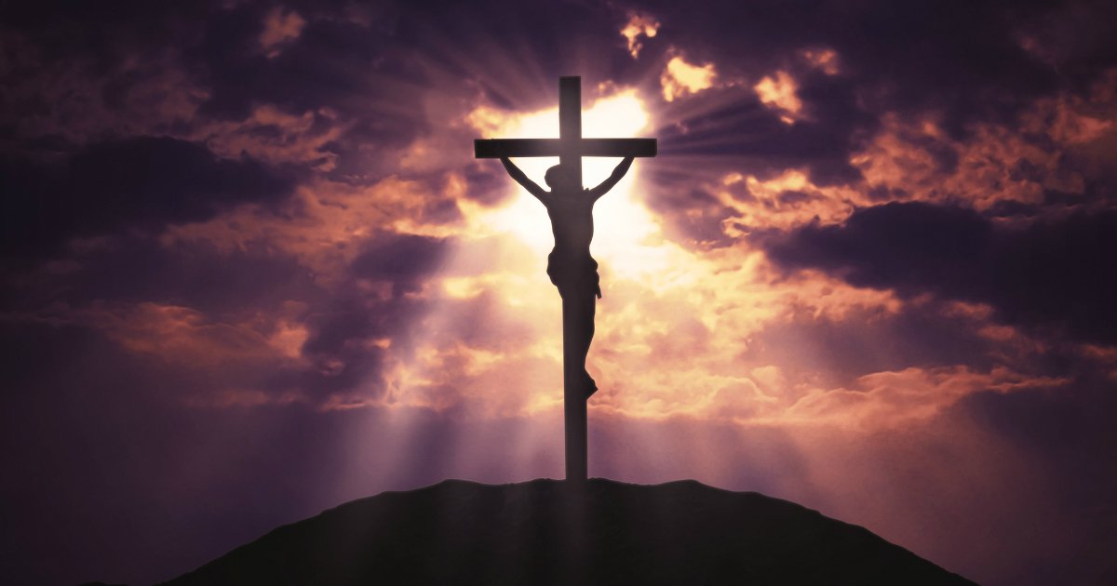
Isa 53:6
All we like sheep have gone astray; we have turned every one to his own way; and the LORD hath laid on him the iniquity of us all.
KJV

Slide 12
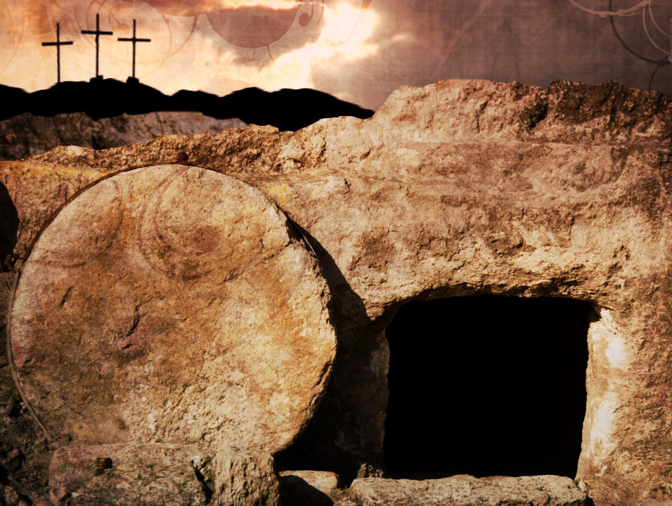
Isaiah knew that His resurrection was part of the plan.
Isa 53:10
But it was the Lord's good plan to crush him and cause him grief. Yet when his life is made an offering for sin, he will have many descendants. He will enjoy a long life, and the Lord's good plan will prosper in his hands. NLT

Slide 13
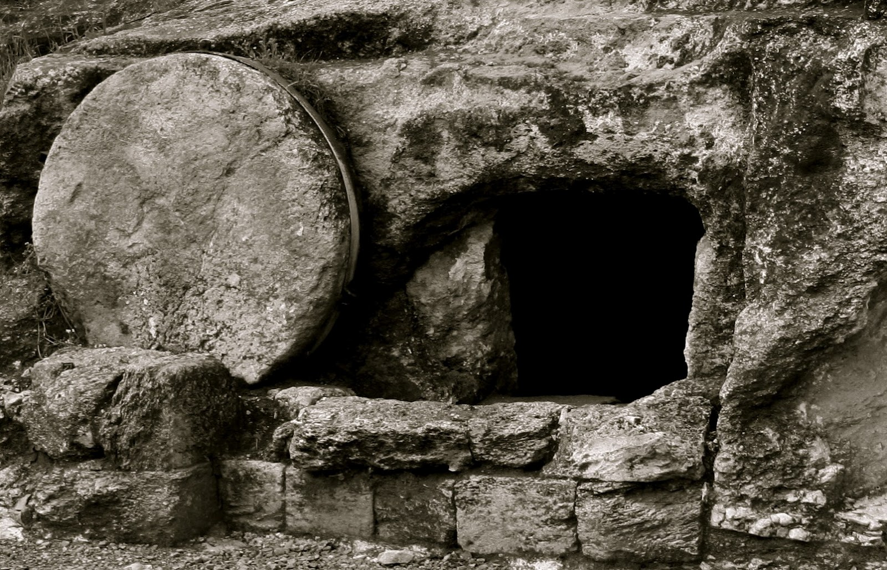
Ps 16:9-10
Therefore my heart is glad, and my glory rejoiceth: my flesh also shall rest in hope.
10 For thou wilt not leave my soul in hell; neither wilt thou suffer thine Holy One to see corruption.
KJV

Slide 14
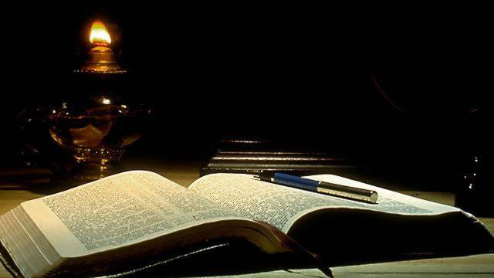
Heb 11:6
But without faith it is impossible to please him: for he that cometh to God must believe that he is, and that he is a rewarder of them that diligently seek him.
KJV

Slide 15
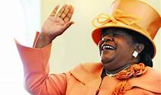
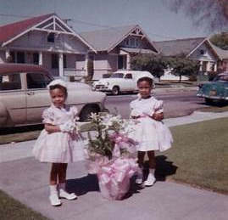
Step #1 Information
Lesson scripture has been read
Many people know easter is huge, but they don’t know why

Slide 16
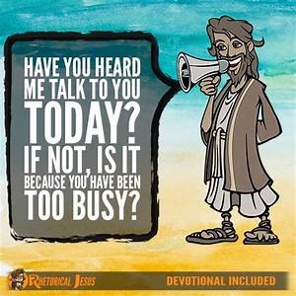
Step #2 Interpretation
-Why Don’t we see Jesus?

Slide 17

Step # 3 Believing
When we see Jesus

Slide 18
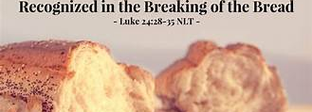
Step#4 Revelation
The disciples realized they should recognized Jesus all along

Slide 19
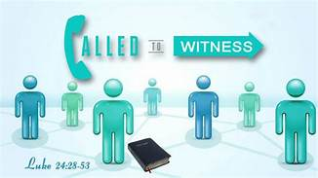

Step#5 application
TruthCasting - "LUKE 24: 28-53" by TONY CLARK - Calvary Chapel of Newport News - Newport News, VA
www.truthcasting.com 640x360
View Image
View Page
ARE YOU A MESSENGER OF HOPE?

Slide 20
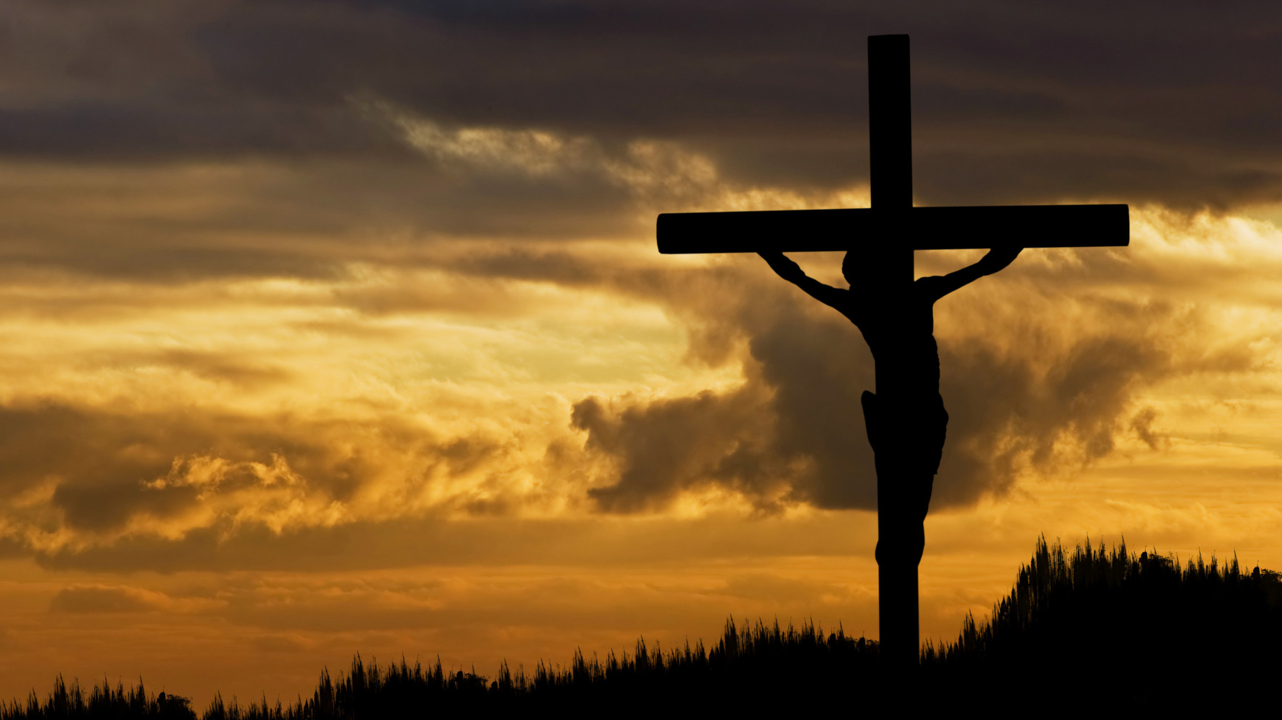
As you climb the ladder of success
And the Blessings, They Begin to Pour In
Make Sure
That Your Never too Busy
To Praise Him
As He Wakes You Up Everyday
Don't Forget to Lift Your Hands and Give Him the Praise
Make Sure
That Your Never too Busy
To Praise Him

Slide 21
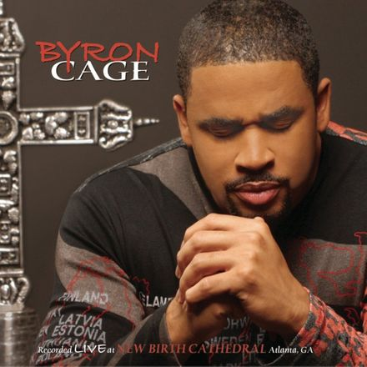
Never Too Busy
Byron Cage
Album Live at New Birth Cathedral
He's been too good
He's been too kind
For you to push him away
And say that he won't mind
He's been too good
He's been so good
So make sure
That your never too busy (to shout hallelujah every now and then)
Your never too busy (to clap your hands and give God some glory)
That Your never too busy (to shout for joy because the joy of the Lord it is your strength)
That your never too busy (to dance around in a circle and don't care who's lookin')
Your never too busy
To praise Him
You Gotta' Trust In Him in Everything You do
And All These Things
They're going to be added unto you
Make sure
That your never too busyu praise Him

Slide 22
You Gotta' Trust In Him in Everything You do
And All These Things
They're going to be added unto you
Make sure
That your never too busy to praise Him

